Slide 1
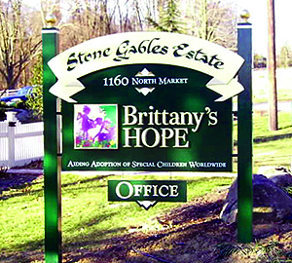
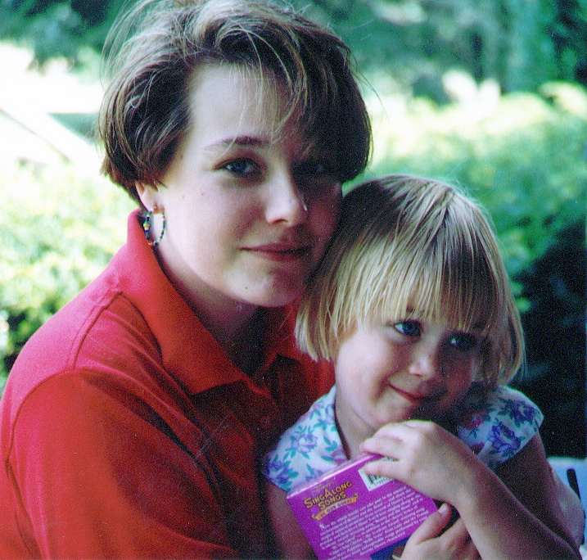
A LIFE INSPIRES A FOUNDATION

Slide 2
THE ROSARY INITIATIVE

Slide 3
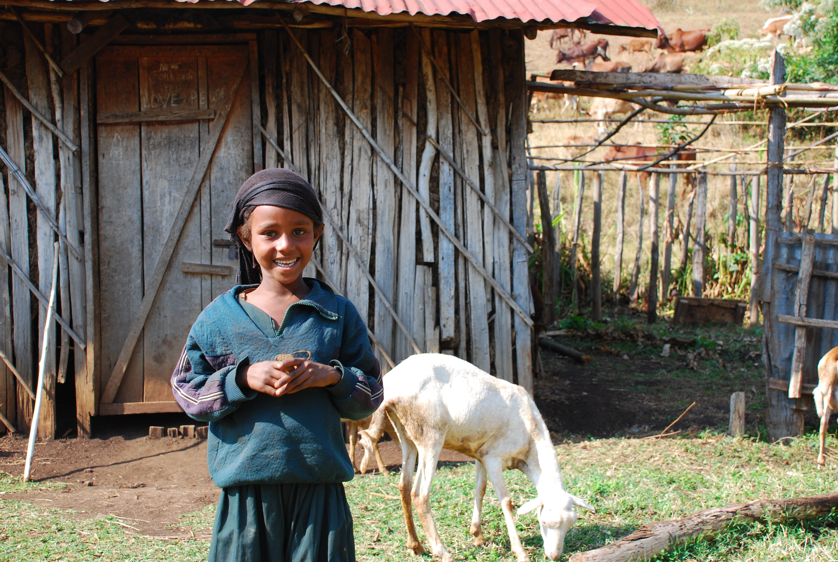
A STRATEGIC PARTNERSHIP
with
Lighthouse Catholic Media

Slide 4
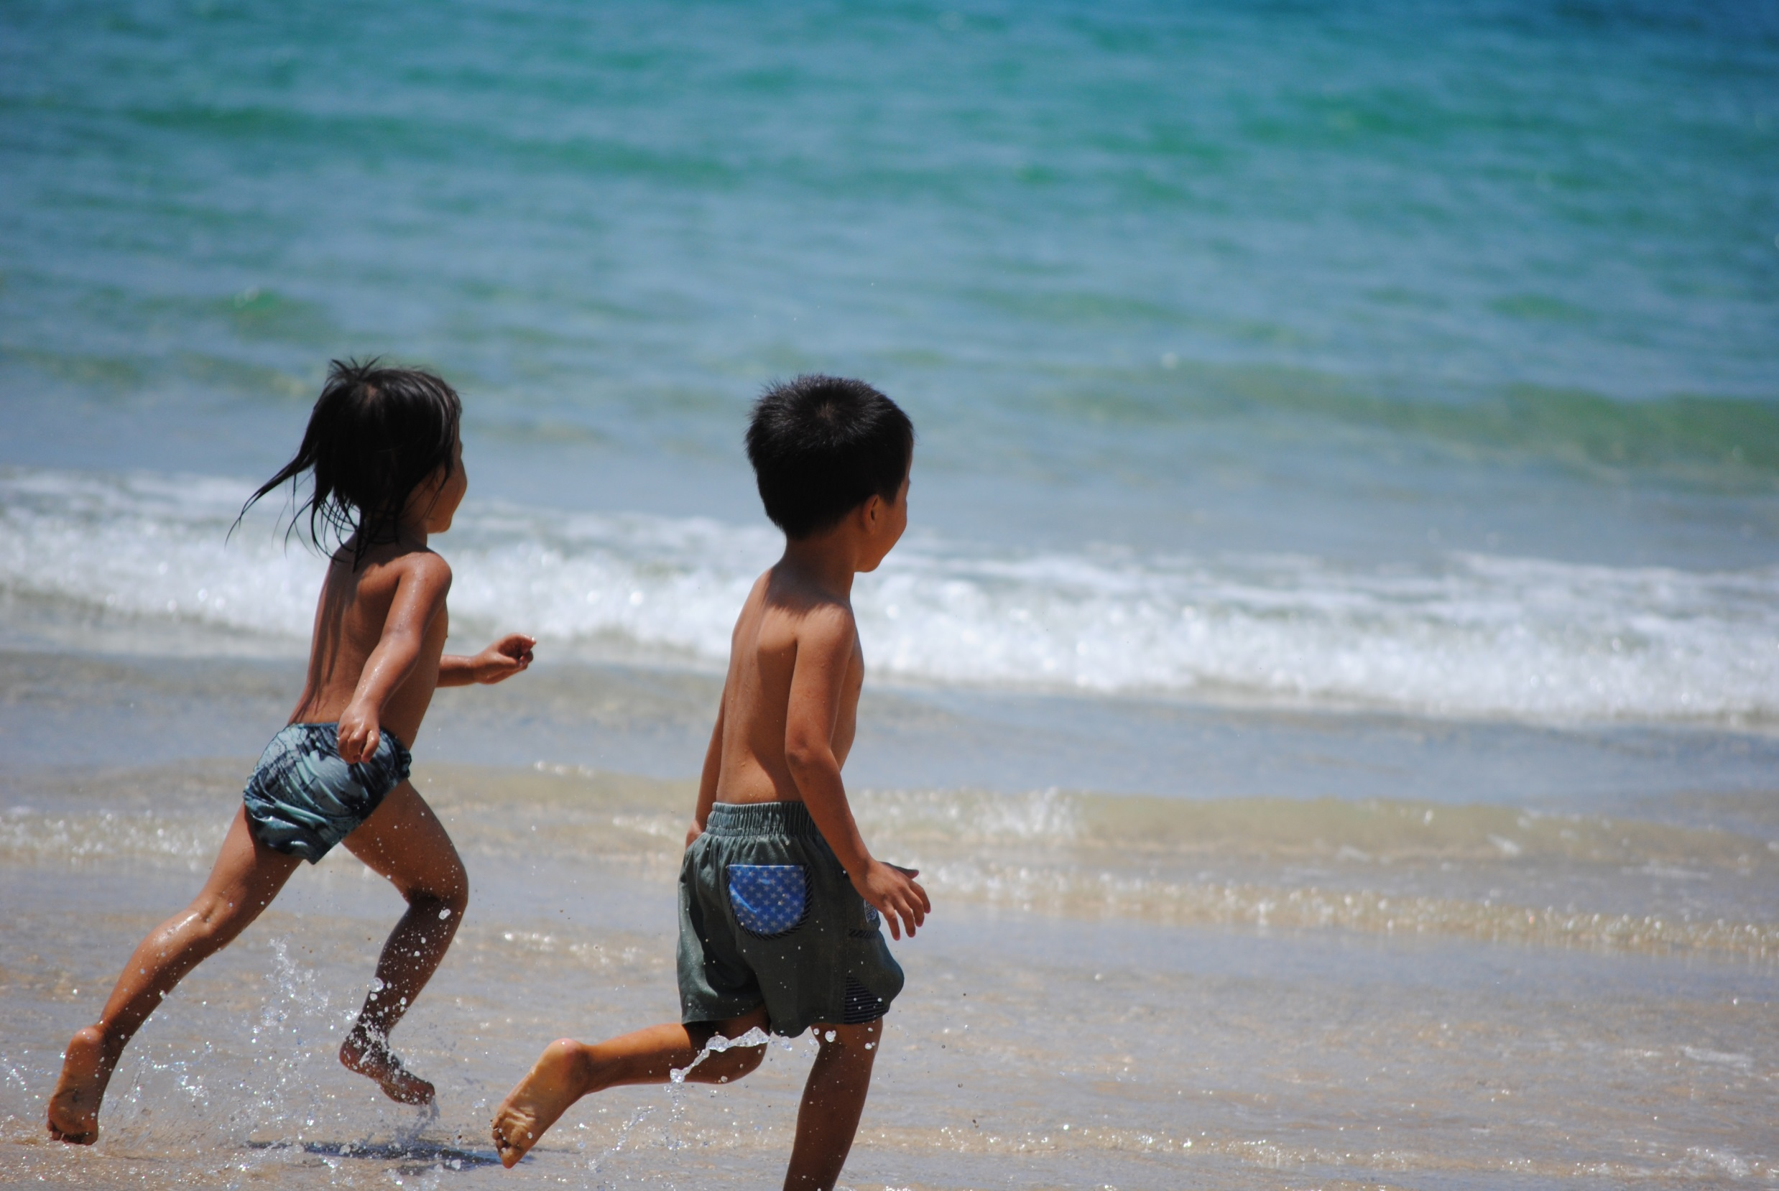
OUR MISSION
AIDING ABANDONED CHILDREN WORLDWIDE
http://www.youtube.com/watch?v=nMmB33FPAt0

Slide 5
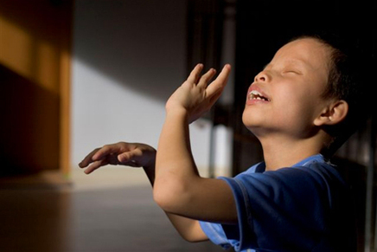
I SEE THE LOVE OF GOD THROUGH OTHERS

Slide 6
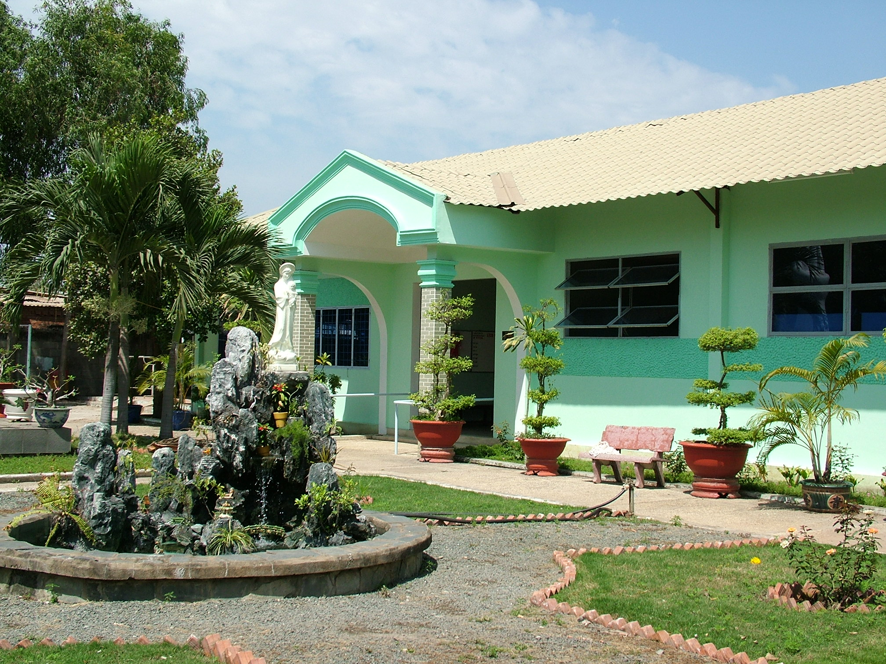
HUYNH DE NHU NGHIA CENTER FOR THE BLIND
HUYNH DE NHU NGHIA CENTER FOR THE BLIND
Vietnam
ROSARIES HELP NUNS PROVIDE A SAFE HAVEN FOR FORGOTTEN CHILDREN

Slide 8
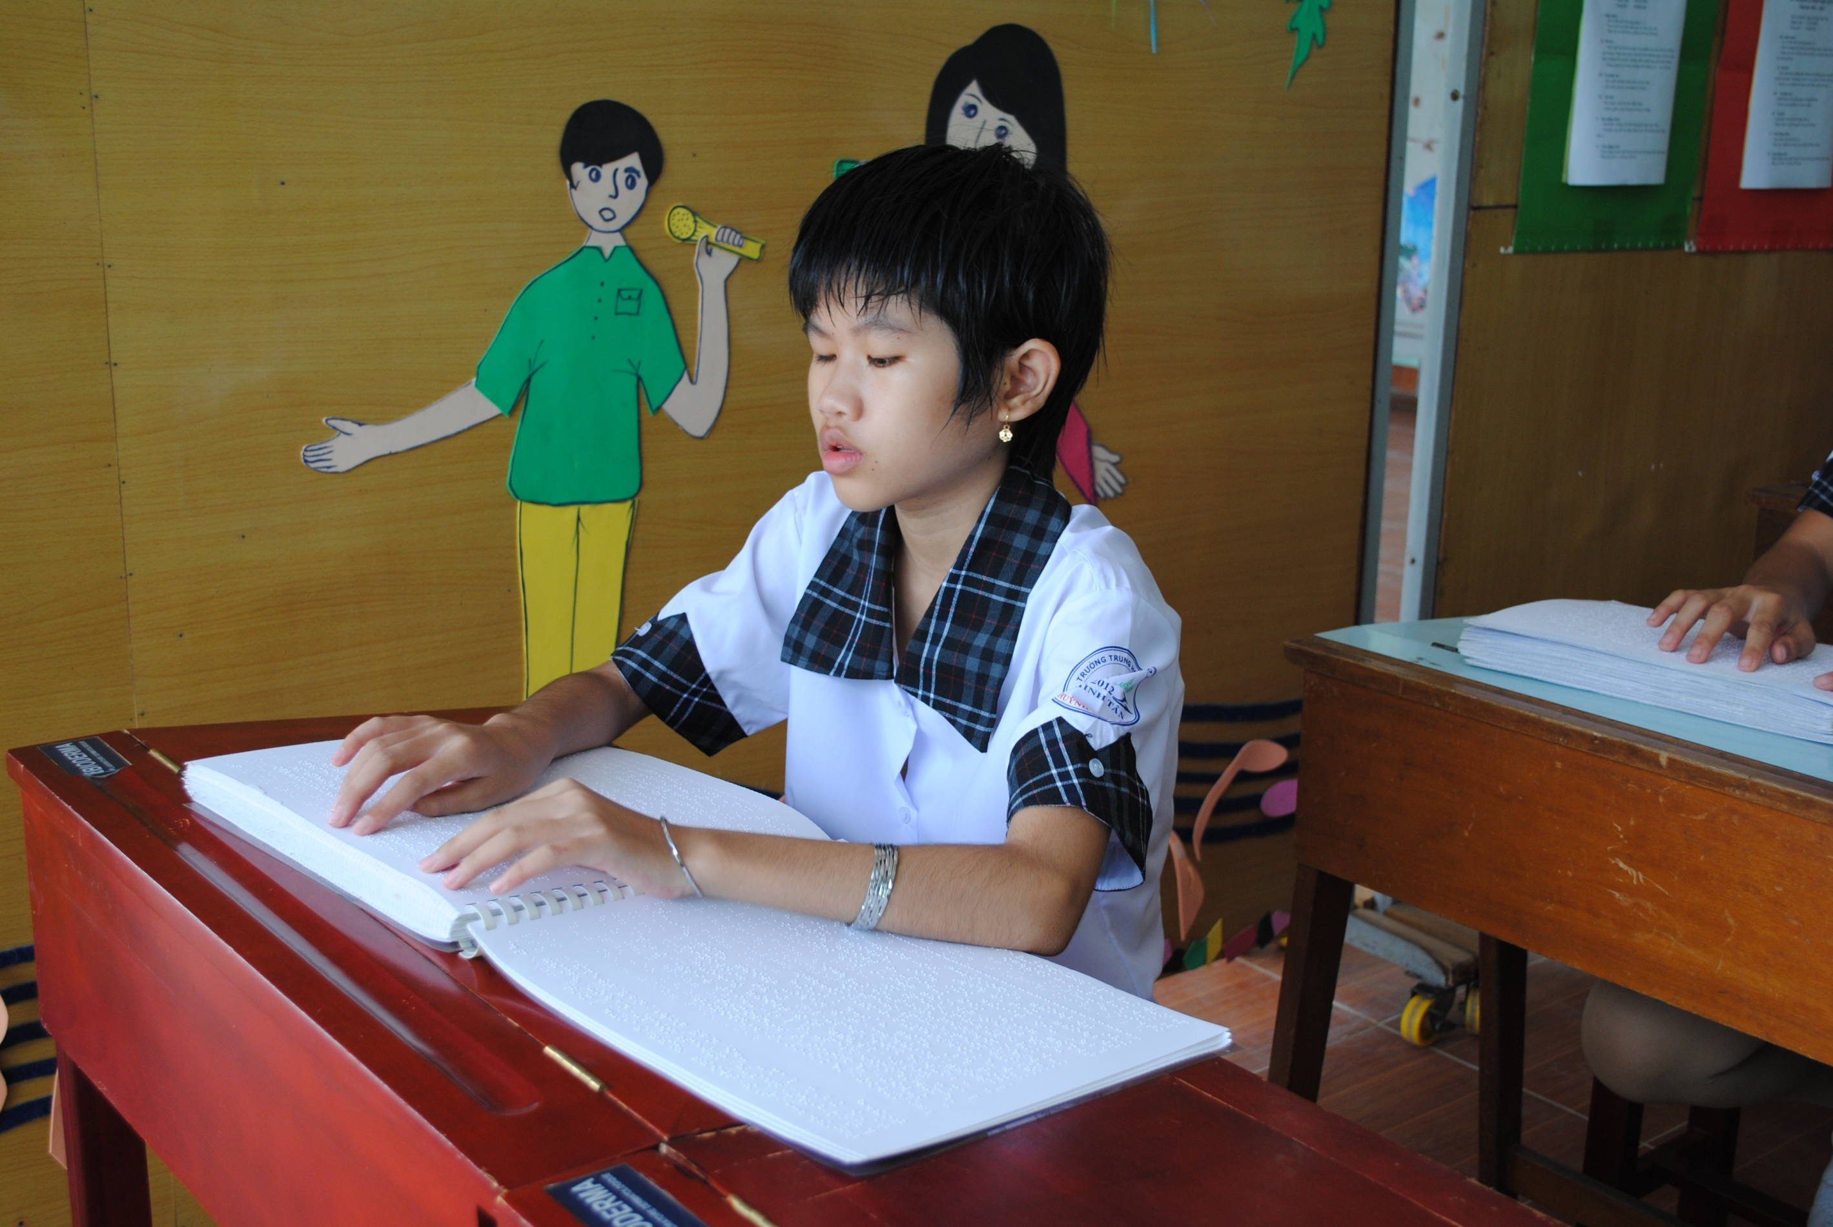

Slide 9
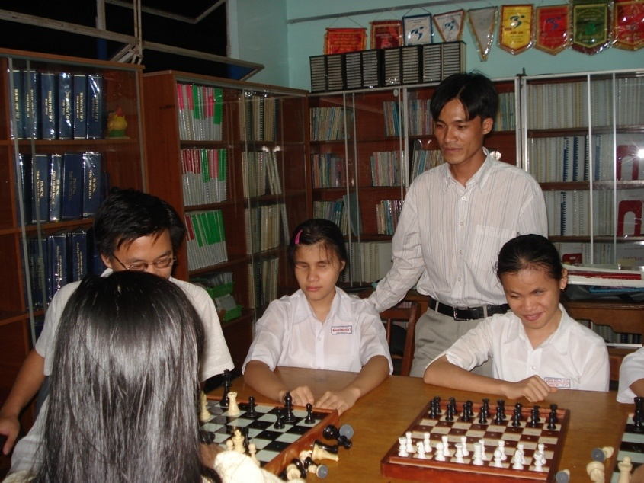

Slide 10
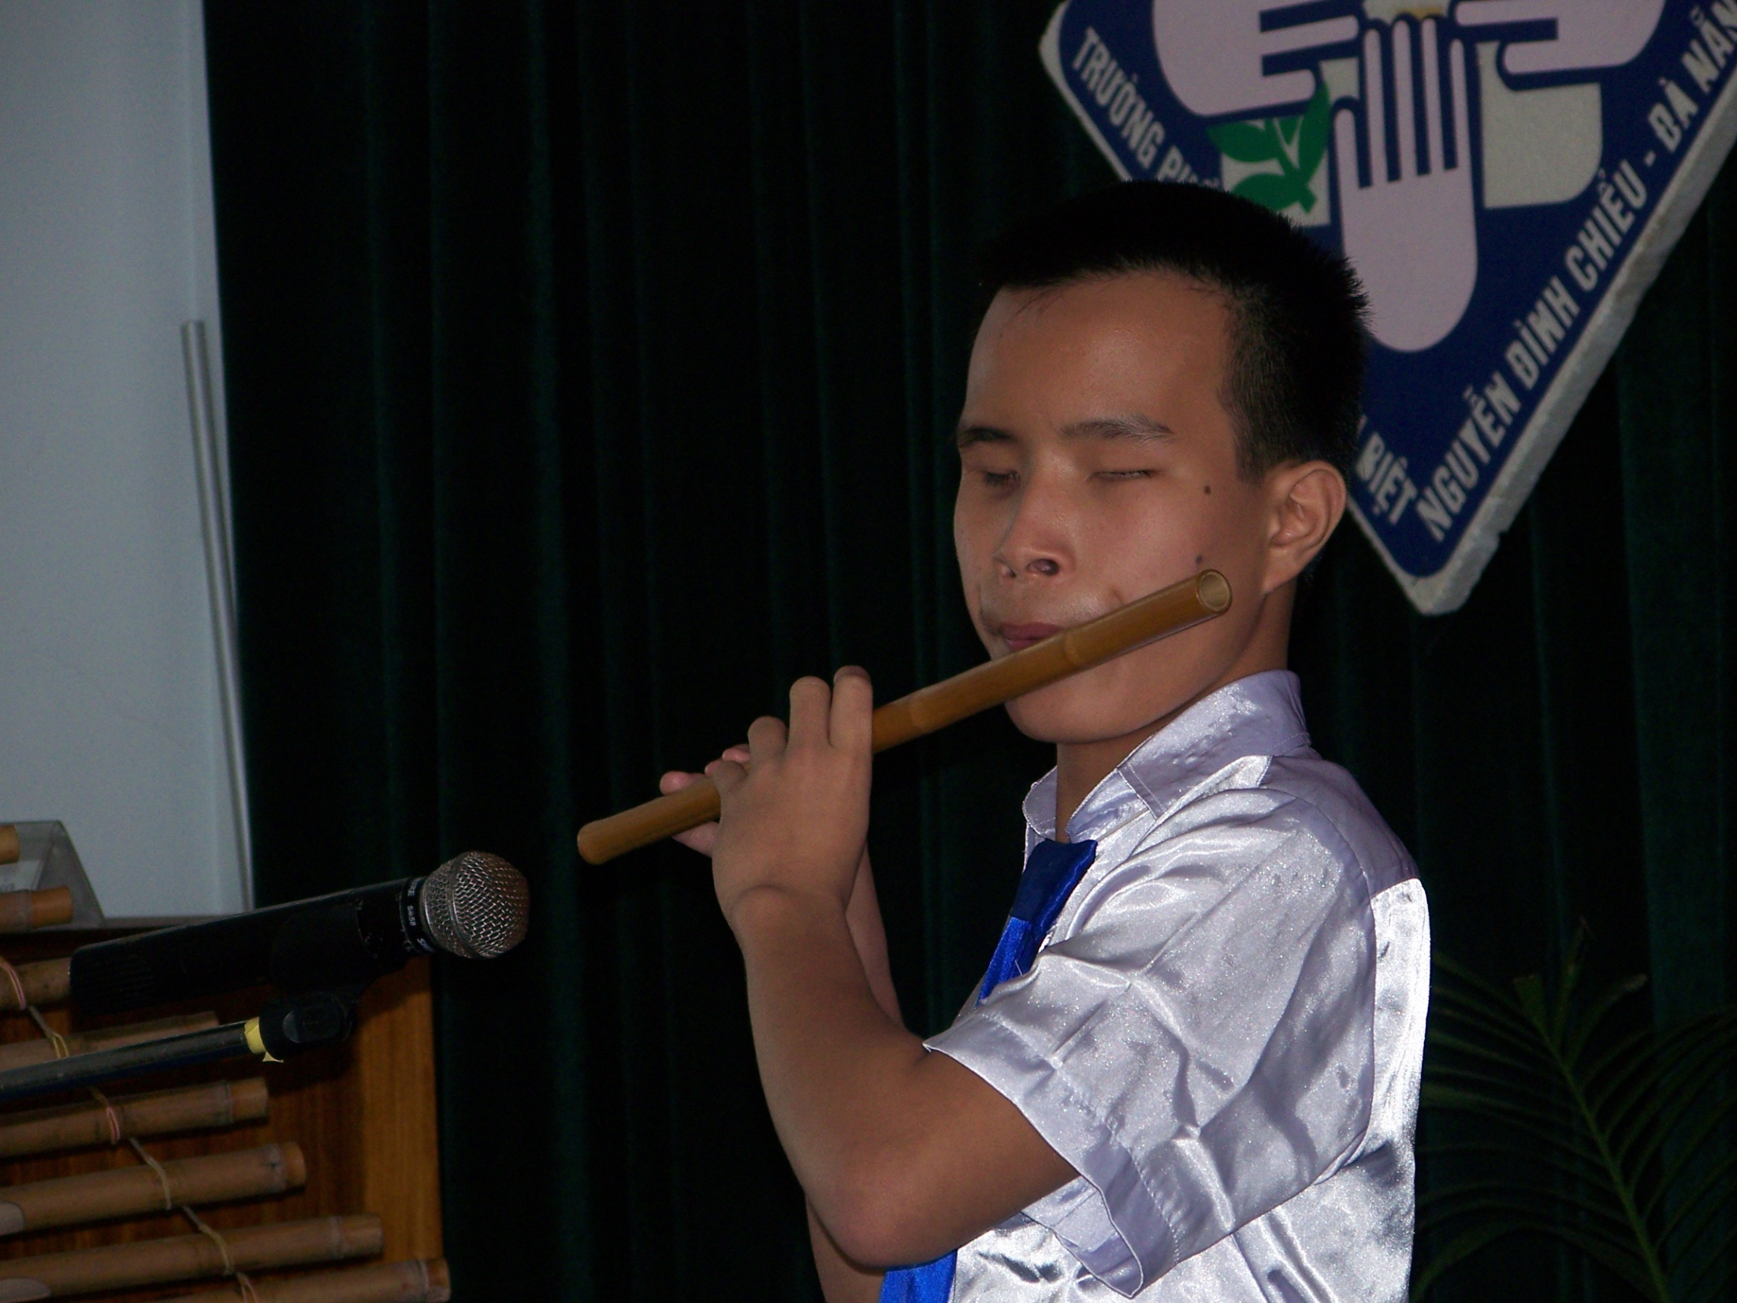

Slide 11
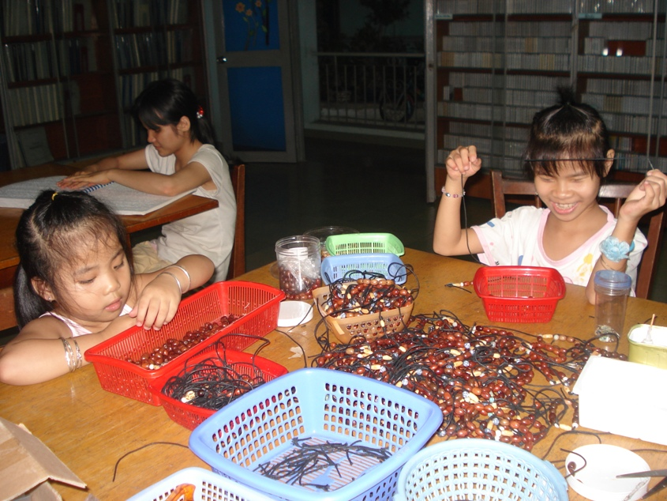
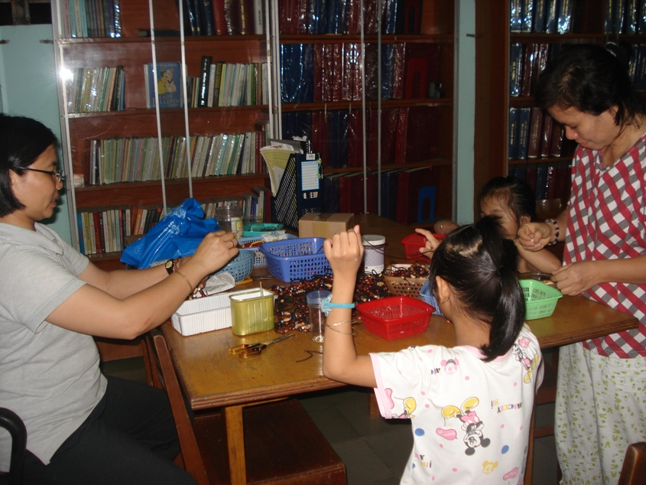
JOINING IN THE FUN

Slide 12
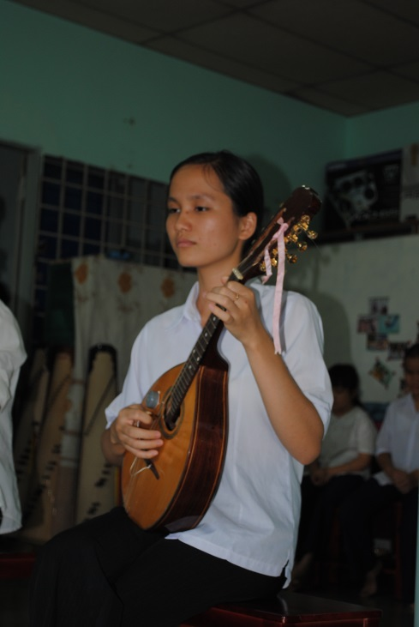

Slide 13
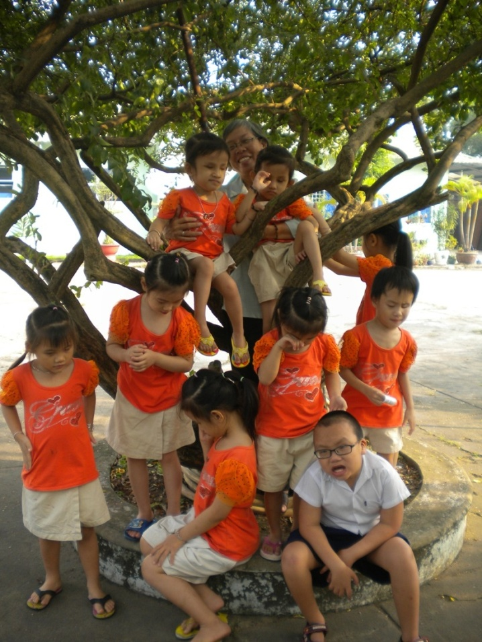
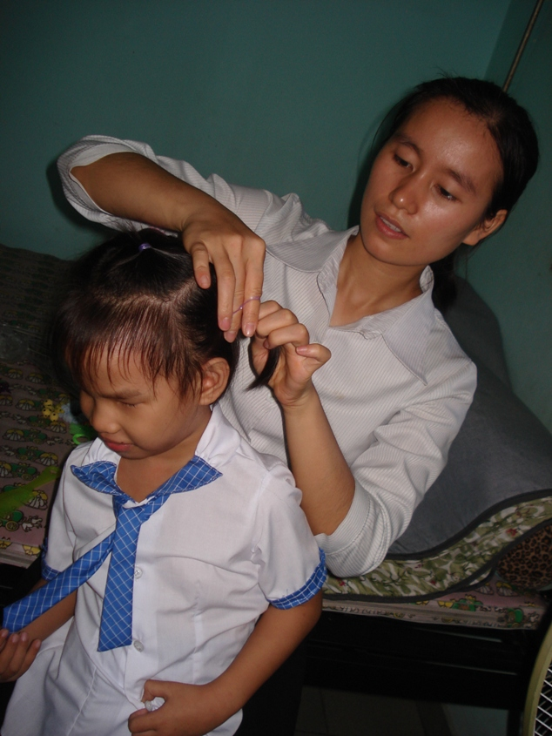

Slide 14
YOUR IMPACT….

Slide 15
BUT MORE WORKS NEED TO BE DONE ….

Slide 16
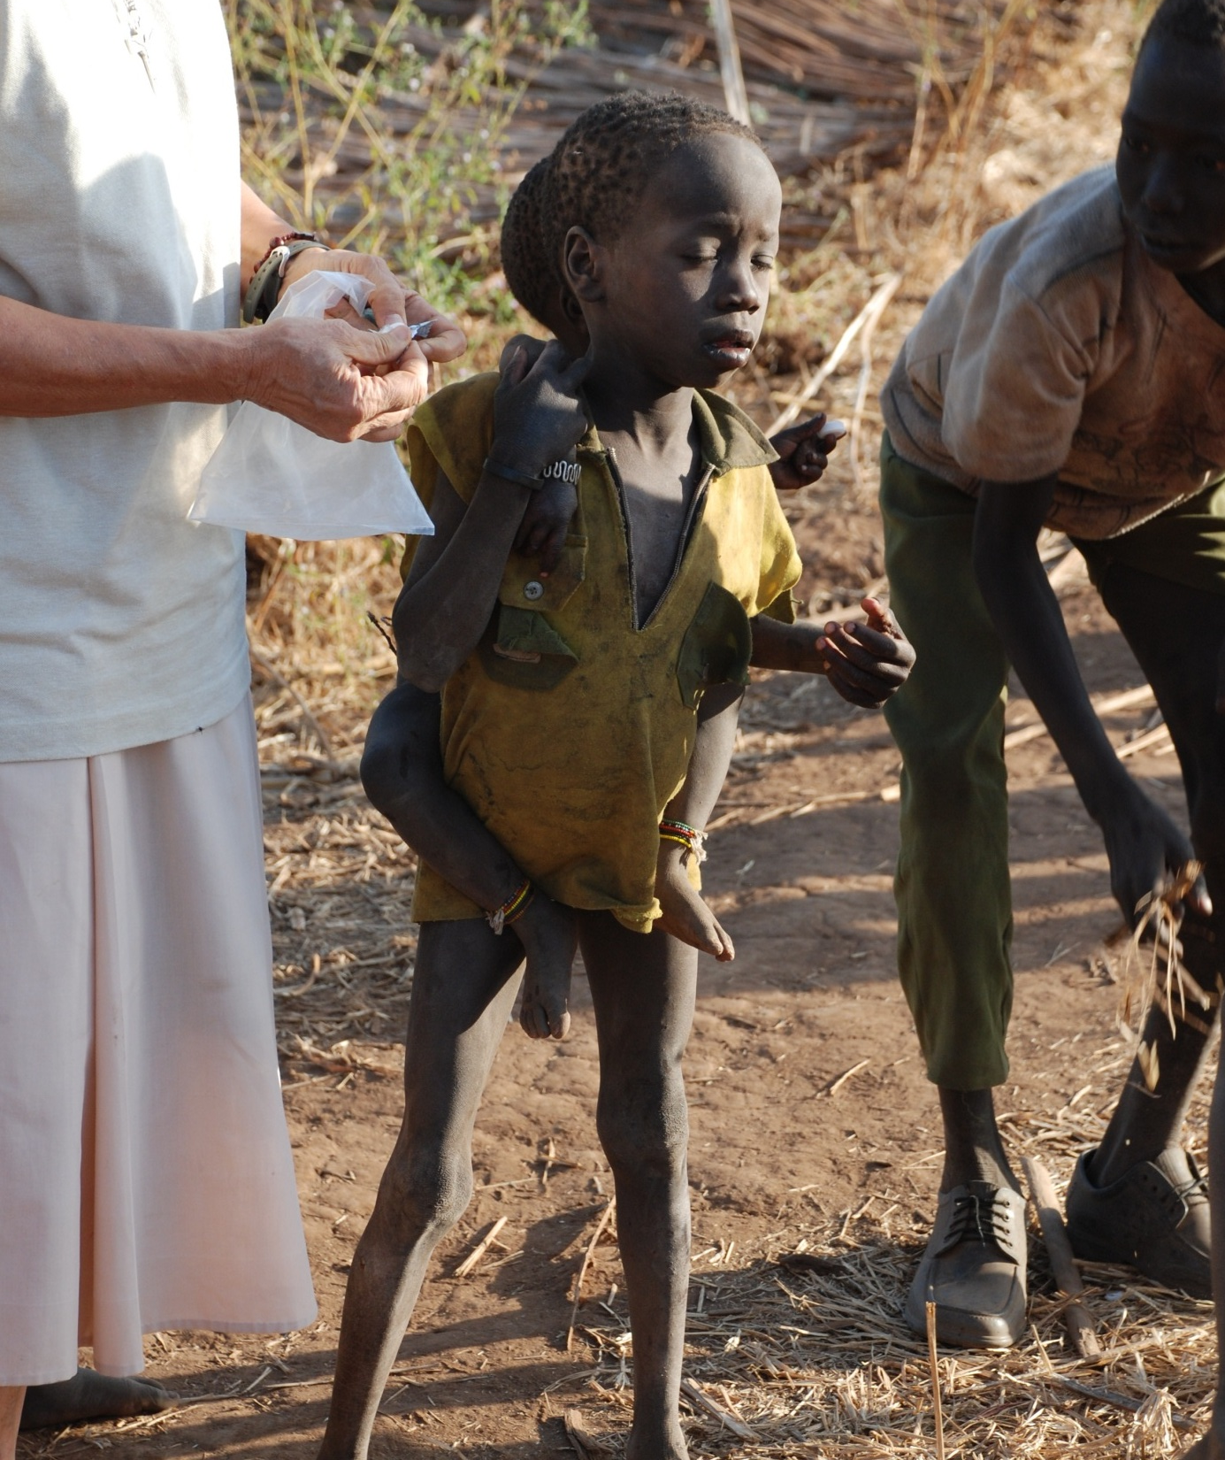
CHILDREN WITH NO ONE TO CARE FOR THEM

Slide 17
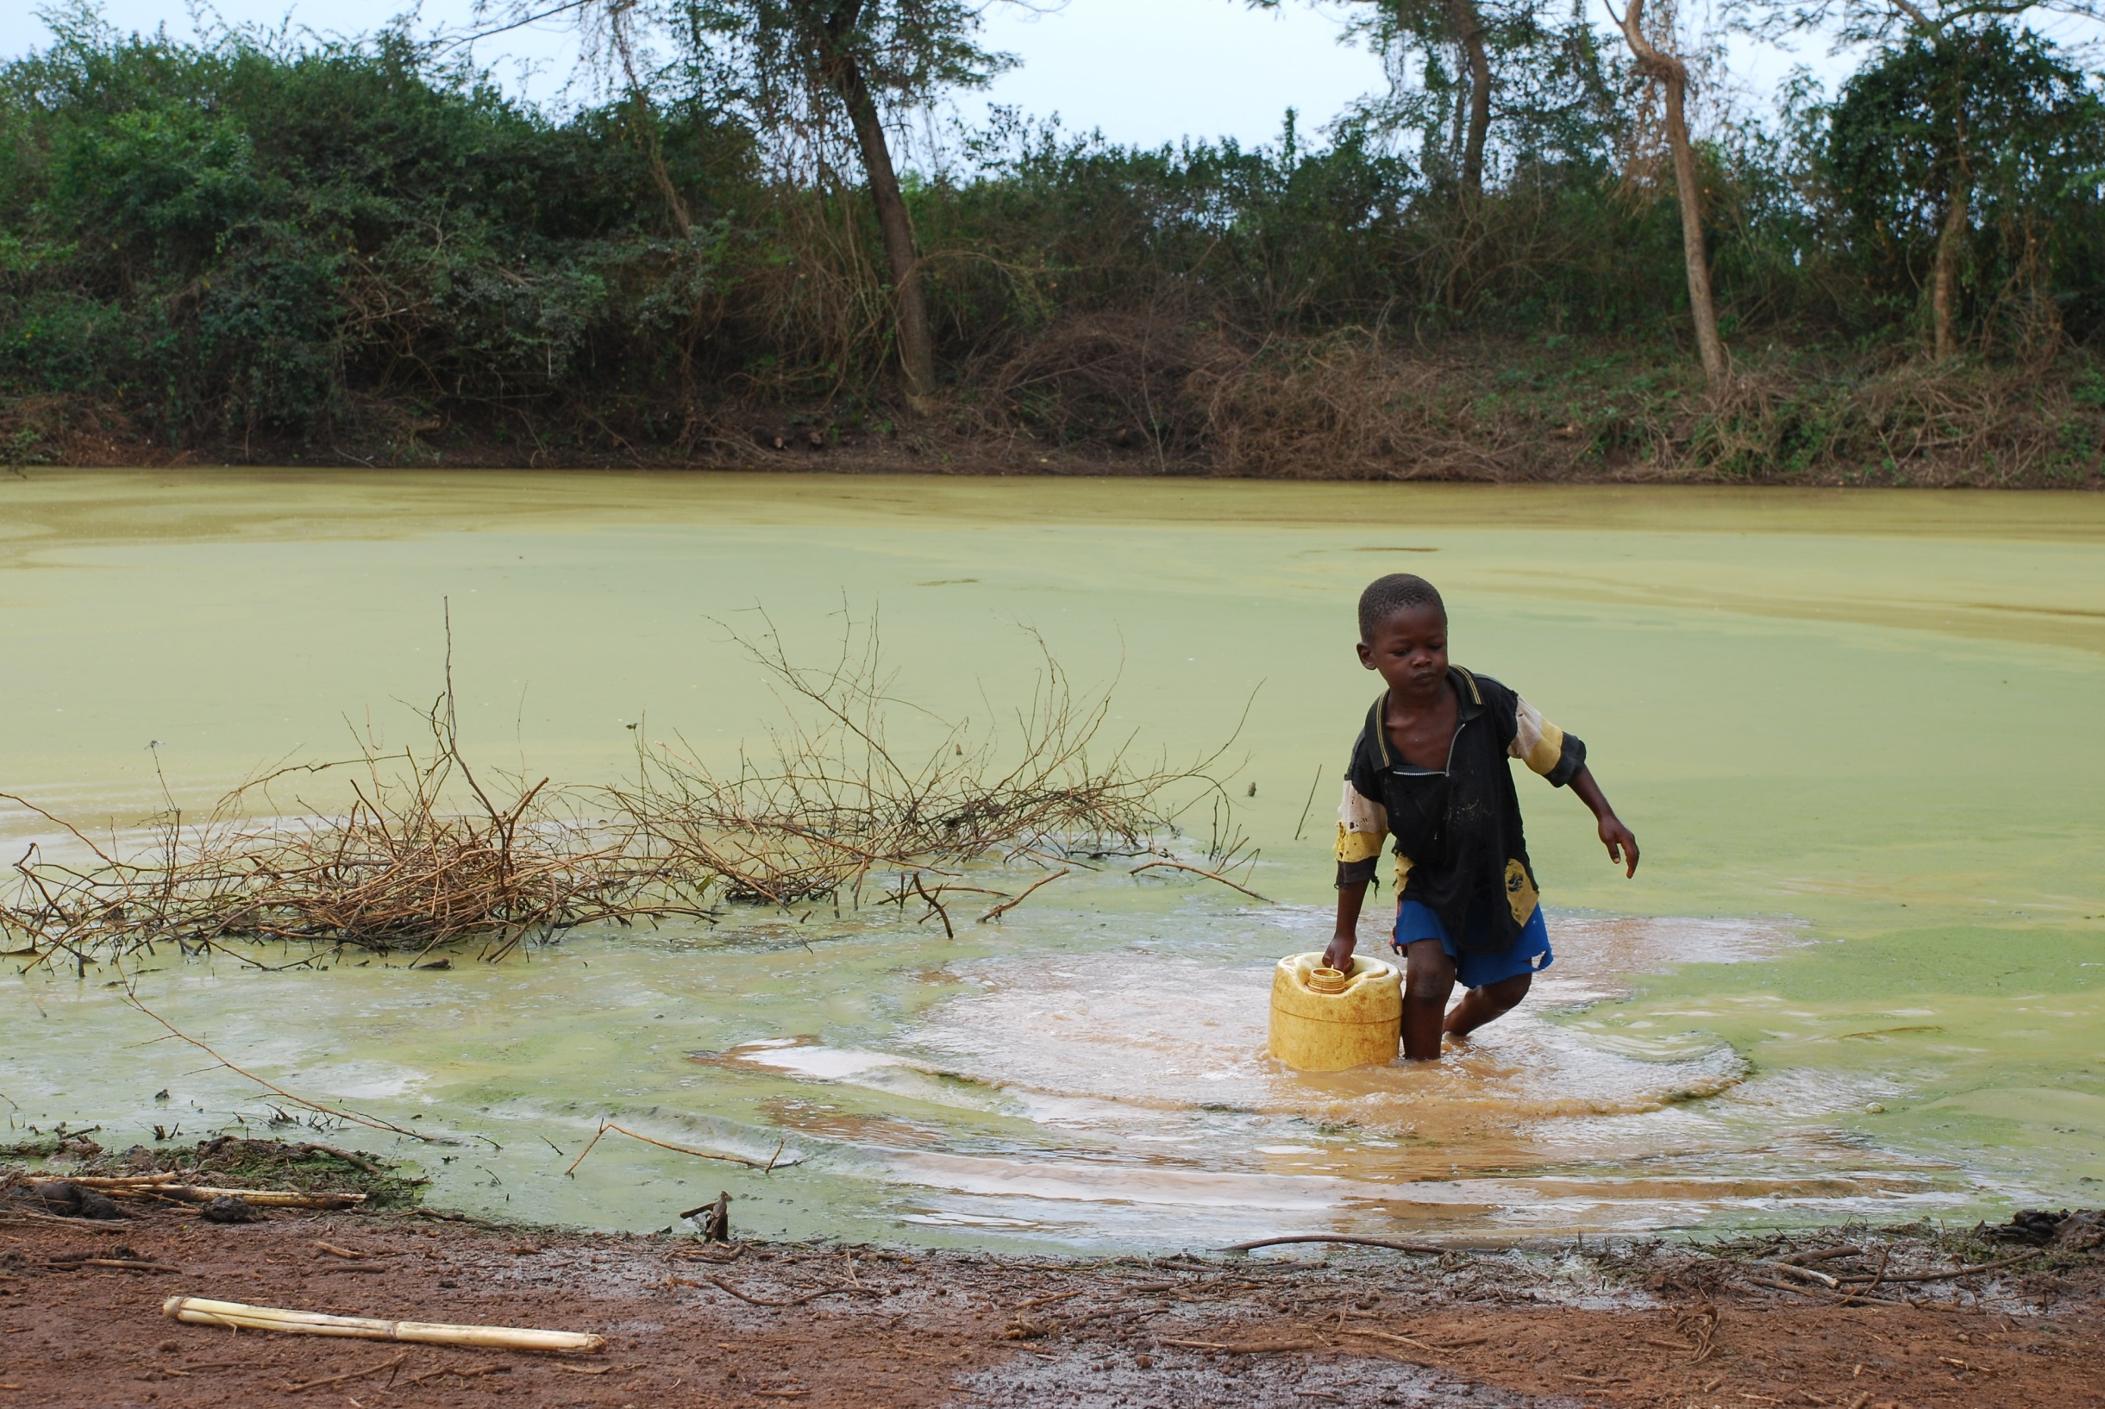
WITHOUT CLEAN WATER

Slide 18
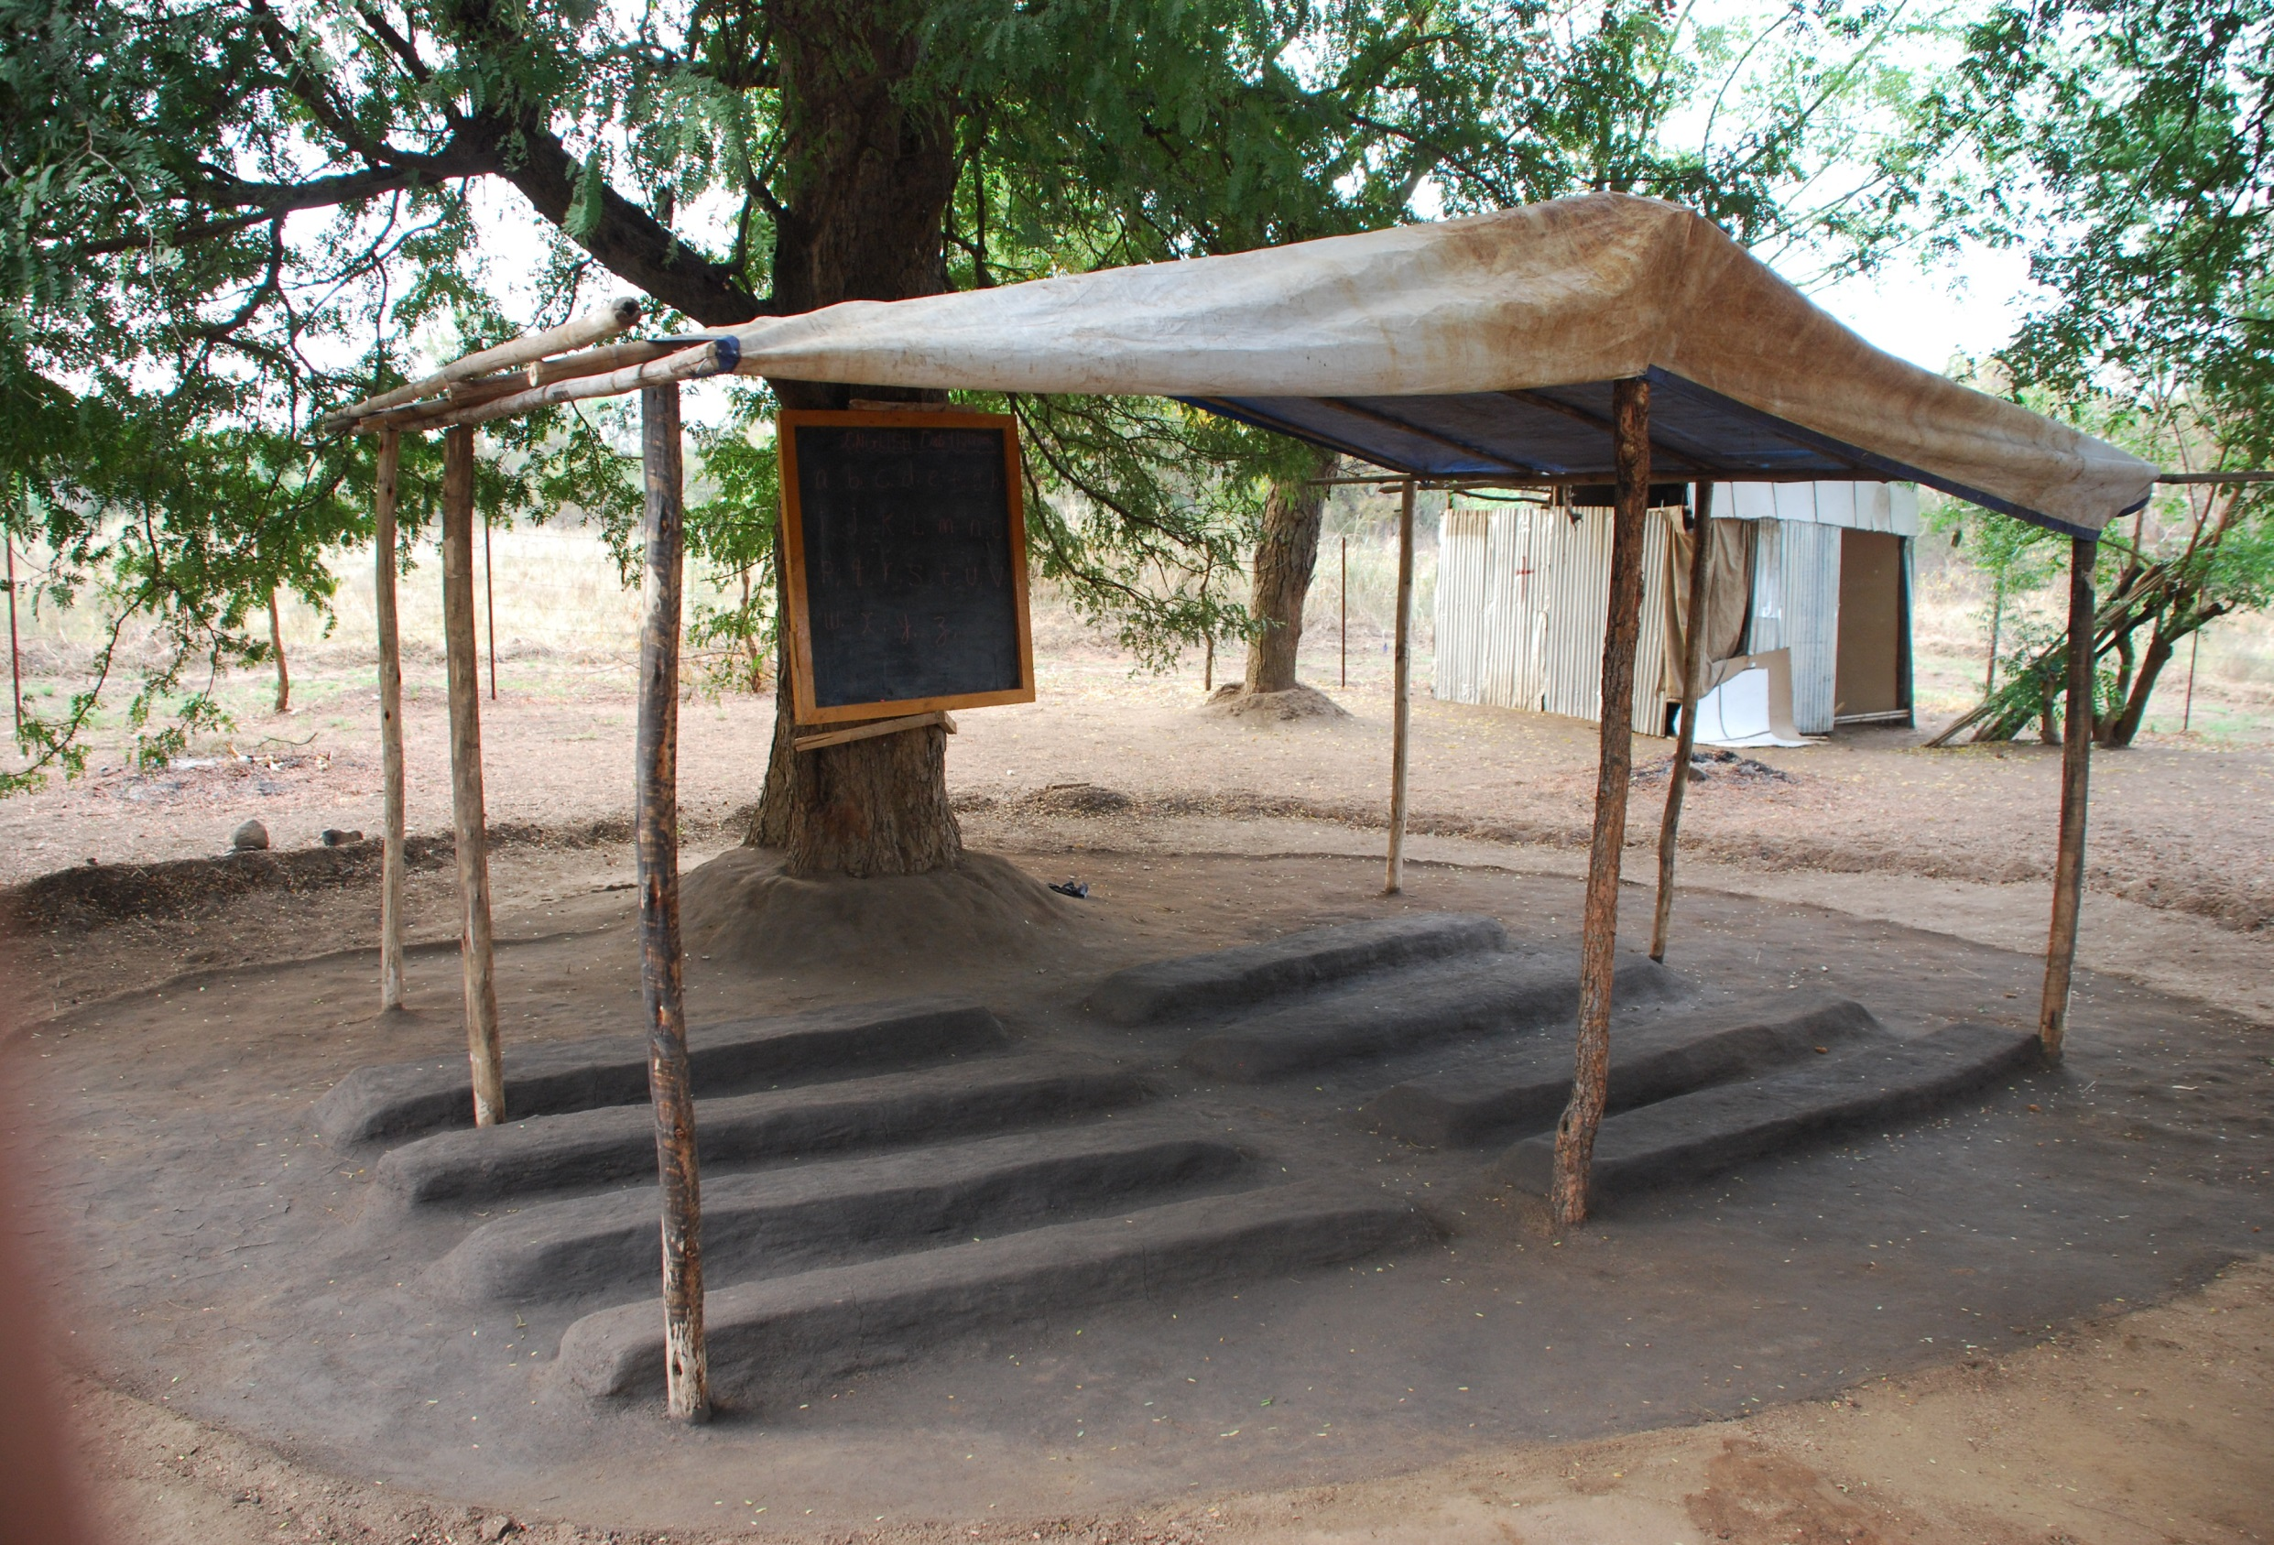
LACKING EDUCATION AND SPIRITUAL DIRECTION

Slide 19
NO PLACE TO CALL HOME

Slide 20
And without
HOPE

Slide 21
THANK YOU !!!!
http://www.brittanyshope.org/
http://www.youtube.com/watch?v=nMmB33FPAt0
….

